Slide 1
Golang Course
Kick-off meeting
Sergey Shtripling
CONFIDENTIAL | © 2021 EPAM Systems, Inc.

Slide 2
How will the process look like?

Slide 3
Course plan
In this course we going to cover most important topic for Golang developer. We start from Golang basics, after that cover such important topics as Web programming, REST, gRPC, and finalize it with explicit concurrent programming with Golang. As well we will touch such important topics as a databases, Linux and Docker.
Course introduction
Golang basics
Slices, Arrays, Maps
Structures, Methods, Interfaces, dependency management
Testing, Debugging in Golang
Git essentials
Networking in Golang
Networking practical lesson
Docker practical lesson
PostgreSQL practical lesson
MongoDB practical lesson
Concurrency in Golang
Concurrency in Golang practical lesson

Slide 4

Course plan
What we want from students:
Solve all programming assignments
Solve tests for average 70 %
Nice to have:
Solve final Home task (Web application)
Be proactive and ask us questions ☺

Slide 5
A few things about Golang

Slide 6
A few things about Golang (Go)
Go is a static-typed compiled language with garbage collector and simple concurrency model
Go is open-source language, you can use it for commercial projects with no fee
A lot of companies starting adopt Golang, market experiencing huge demand for Golang experts
Golang is young language and there is no legacy yet
Golang was developed keeping in mind best practices from books such as (Clean code, Clean architecture and The practice of programming)
Golang is explicit language and follow rule that there is one way to do something good

Slide 7
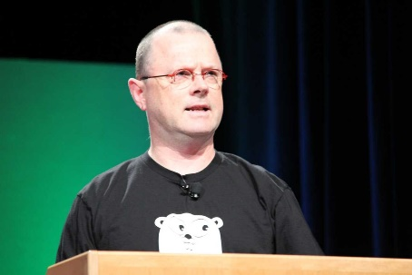
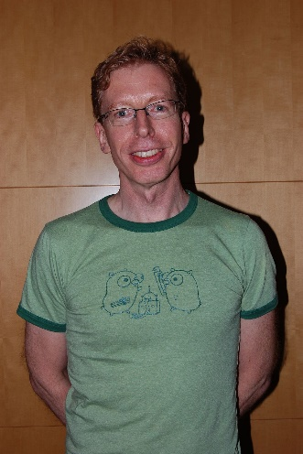
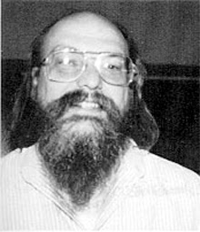
Who developed Golang
Robert Griesemer, Rob Pike, and Ken Thompson - this guys was involved in development C language, Unix, Unicode, OS Plan9.
I think at least Rob Pike and Ken Thompson are familiar names, this guys did a lot of things for Software Engineering industry.

Slide 8
Why people like Go
Golang is compiled language, there is no intepretator or virtual machine like in Java; Golang compiler support cross-platform compilation, on your computer you can compile code for any supported platform or CPU architecture.
Golang is strictly typed and don’t have generics(yet), due to this code generation is used a lot.
Golang has built-in, production ready HTTP server, you don’t have to setup tomcat, apache or unicorn to run web application.
Language built with backward compatibility in mind, there is no much changes from version 1.0, instead of developing new and new part of the language, Go lang team improved existing one, you will receive benefits from each new version doing changing nothing in your code.

Slide 9
Why to learn Golang

Slide 10
Why to learn Golang ?
No legacy, Golang is young language (First version released in 2009), a lot of companies already started Golang, but don’t have a big old codebase.
Golang is used a lot for cloud native development, cloud change our way how we develop and run our applications, in case you want to be a part of this, Golang is the best candidate.
Golang is simple and fast, you don’t have to spend much time to optimize the code, in case you write Golang code according to general guidelines, application will be fast enough in most cases.
Concurrent by design, Golang has built-in primitives to run concurrent programs go routines (green threads) and channels help you to develop concurrent code without pain.

Slide 11







Why to learn Golang ?
In future world Golang used a lot, for writing distributed systems.
Such companies as (Google, Lyft, Uber, Twitter and Facebook, Gitlab) already use Golang for their systems.
A lot of systems which drive future word such as Docker, Kubernetes and Google Cloud written at Golang as well.

Slide 12

Should I start with Go?
What so good about go
Go is designed to "learn fast and write clean code"
Simple syntax, strict solutions
Useful habits
Strong typing
Go for dummies – 176 pages. (comapre 900+ C++)
TMTOWTDI in python VS usually single way in Go
Some magic in js VS predictable behavior in Go

Slide 13
Development environment

Slide 14



Development environment

Slide 15
Development environment – Goland
Install Golang - https://golang.org/doc/install
Install IDE - https://www.jetbrains.com/go/download
Students license - https://www.jetbrains.com/student/
Benefits:
Easy to setup
Provide huge support for debugging, reading code
Provide support for external tools which automate some routine work
Validate code in live time while you write code
Free for students
Pitfalls:
It’s too simple, developers which use this IDE forget how to perform build/run/deploy without IDE
Resource consuming, you need a huge amount of memory and CPU cycles
Cost $199.00 per year

Slide 16
Development environment – Vim
Install Golang - https://golang.org/doc/install
Install Vim - https://www.vim.org/download.php
Read how to exit from vim :) –
https://stackoverflow.com/questions/11828270/how-do-i-exit-the-vim-editor
Generate .vimrc file and download it -
https://vim-bootstrap.com
Benefits:
Simple to move configuration from one PC to another just move one file
Provide simple but robust command set for work with text
Allow you huge customization possibilities
Pitfalls:
Hard to exit :)
Hard to learn all commands in short time, without commands hard to solve common things

Slide 17
Development environment – VS Code
Install Golang - https://golang.org/doc/install
Install VS Code - https://code.visualstudio.com/download
Add support for Golang –
https://code.visualstudio.com/docs/languages/go
Benefits:
Free to use
Allow customization
Huge community
Pitfalls:
UI/UX less obvious compare to Goland
Longer time for feedback compare to Goland

Slide 18
Communication
Install Slack - slack available on Windows, MacOS and Linux as well as on IOS and Android
Link to join workspace was sent in mail, it will expire on July, 6.
If you have some troubles join after link expiered, contact manager via email to get a new link

Slide 19
Golang tools
build compile packages and dependencies doc show documentation for package or symbol env print Go environment information fmt gofmt (reformat) package sources get add dependencies to current module and install them install compile and install packages and dependencies run compile and run Go program test test packages version print Go version

Slide 20
Hello World
Code
Output
package main import ( "fmt" ) func main() { fmt.Println("Hello world!") }
https://play.golang.org/p/9fyo4SnkpuZ
Hello world!

Slide 21
Format the code
Before formmating
package main;
import ( "fmt");
func
main( ) {
fmt.Println( "Hello, playground" );
};
go fmt main.go
package main
import (
"fmt"
)
func main() {
fmt.Println("Hello, playground")
}

Slide 22
Build code
Build a file:
go build ./main.go
(builds binary using just this file, binary will be created in PWD, binary name will be file name without file extension (main) in this case).
Build a package:
go buid ./cmd/entrypoint/
(builds binary using a whole package and all it’s imports, binary will be created in PWD, binary name will be last directory name (entrypoint) in this case)
Build with custom binary name:
go build -o /tmp/binary ./cmd/entrypoint/ | ./main.go
(builds binary using a whole package and all it’s imports or file, binary will be created under relative or full path specified in -o flag binary name will be last segment of the path(binary) in this case)

Slide 23

Development environment – Goland
Install Golang - https://golang.org/doc/install
Install IDE - https://www.jetbrains.com/go/download
Students license - https://www.jetbrains.com/student/

Slide 24

Development environment – Vim
Install Golang - https://golang.org/doc/install
Install Vim - https://www.vim.org/download.php
Generate .vimrc file and download it https://vim-bootstrap.com or install go vim plugin https://github.com/fatih/vim-go (this is more for vim experts)

Slide 25

Development environment – VS Code
Install Golang - https://golang.org/doc/install
Install VS Code - https://code.visualstudio.com/download
Add support for Golang – https://code.visualstudio.com/docs/languages/go

Slide 26
Homework

Slide 27
Send homework to review
mkdir lesson_01 && cd lesson_01
git checkout -b lesson_01
//put your code
git add .
git commit -m "Lesson 01 task"
git push -u origin lesson_01
Create a pull request: https://github.com/yourname/yourrepo/pulls to master branch from lesson_01 branch
Inform mentors

Slide 28
How to start my homework
Create(if not yet) account on github.com(gitlab.com or bitbucket.org will fit too, if you prefer, github.com is recommended)
Create a repo https://github.com/new
Name should be like `gocourse` or smth like this
Create Public repo (it's possible to create private and your mentors as colaborators)
Go to your console:
git init .
go mod init github.com/myuser/myrepo
touch README.md
git add .
git commit -m "Initial commit"
git remote add origin git@github.com:yourname/yuorrepo.git
git push -u origin master

Slide 29
Homework how to submit tasks
Create new application
Use emoji package "github.com/kyokomi/emoji" to say `Hello, world ☺` with emoji
Run it
Next slide provides explanation, use it as a source or ask slack channels for help

Slide 30
Homework step-by-step
go mod init github.com/myuser/myrepo
Create main.go file with blocks:
import "github.com/kyokomi/emoji"
`func main`
Add fmt.Println("Hello, world, :face:")
go run main.go

Slide 31
Q&A

Slide 32
This is the end! Thank you

